Slide 1
Capstone Project
Capstone Project - The Battle of Neighborhoods Report.
By Soumee Banerjee

Slide 2
Introduction
Background:
The average American moves about eleven times in their lifetime. This brings us to the question: Do people move until they find a place to settle down where they truly feel happy, or do our wants and needs change over time, prompting us to eventually leave a town we once called home for a new area that will bring us satisfaction? Or, do we too often move to a new area without knowing exactly what we’re getting into, forcing us to turn tail and run at the first sign of discomfort? To minimize the chances of this happening, we should always do proper research when planning our next move in life. Consider the following factors when picking a new place to live so you don’t end up wasting your valuable time and money making a move you’ll end up regretting. Safety is a top concern when moving to a new area. If you don’t feel safe in your own home, you’re not going to be able to enjoy living there.
1.2 Problem:
The crime statistics dataset of London found on Kaggle has crimes in each Boroughs of London from 2008 to 2016. The year 2016 being the latest we will be considering the data of that year which is actually old information as of now. The crime rates in each borough may have changed over time. This project aims to select the safest borough in London based on the total crimes, explore the neighborhoods of that borough to find the 10 most common venues in each neighborhood and finally cluster the neighborhoods using k-mean clustering.
1.3 Interest:
Expats who are considering to relocate to London will be interested to identify the safest borough in London and explore its neighborhoods and common venues around each neighborhood.

Slide 3
Data/Libraries Used -
The data acquired for this project is a combination of data from three sources. The first data source of the project uses a London crime data that shows the crime per borough in London.
The second source of data is scraped from a wikipedia page that contains the list of London boroughs.
The third data source is the list of Neighborhoods in the Royal Borough of Kingston upon Thames as found on a wikipedia page
Next we have used Foursquare API to fetch location specific venues from each neighbourhood.
We have used Folium library greatly to visualize the neighbourhoods clearly and have a clear understanding. Also Matplotlib is used.
For data wrangling, analysis and cleaning, we have used Numpy, Pandas.
For ML we have used skit-learn library.

Slide 4
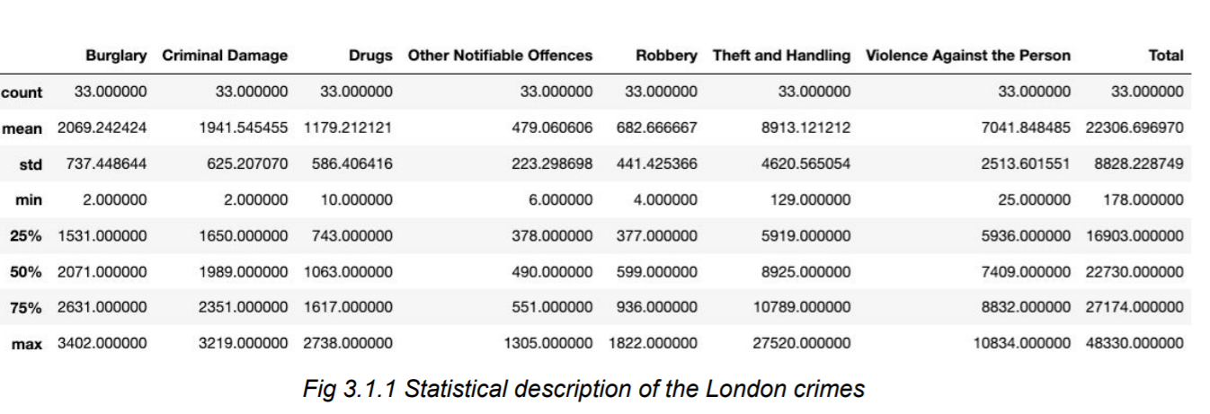
Methodology:
The describe function in python is used to get statistics of the London crime data, this returns the mean, standard deviation, minimum, maximum, 1st quartile (25%), 2nd quartile (50%), and the 3rd quartile (75%) for each of the major categories of crime (See fig 3.1.1).
The data set obtained shown below:

Slide 5
Please note :The count for each of the major categories of crime returns the value 33 which is the number of London boroughs. ‘Theft and Handling’ is the highest reported crime during the year 2016 followed by ‘Violence against the person’, ‘Criminal damage’. The lowest recorded crimes are ’Drugs’, ‘Robbery’ and ‘Other Notifiable offenses’.

Slide 6
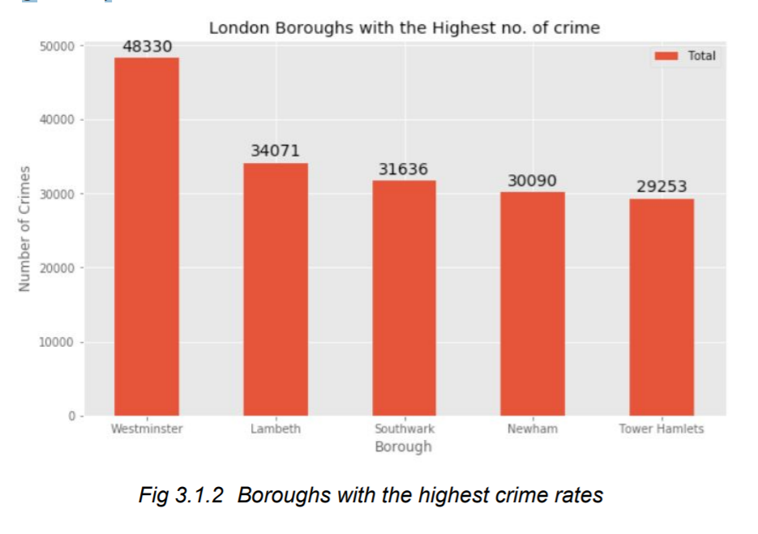
Boroughs with the highest crime rates:
Comparing five boroughs with the highest crime rate during the year 2016 it is evident that Westminster has the highest crimes recorded followed by Lambeth, Southwark, Newham and Tower Hamlets. Westminster has a significantly higher crime rate than the other 4 boroughs (see fig 3.1.2).

Slide 7
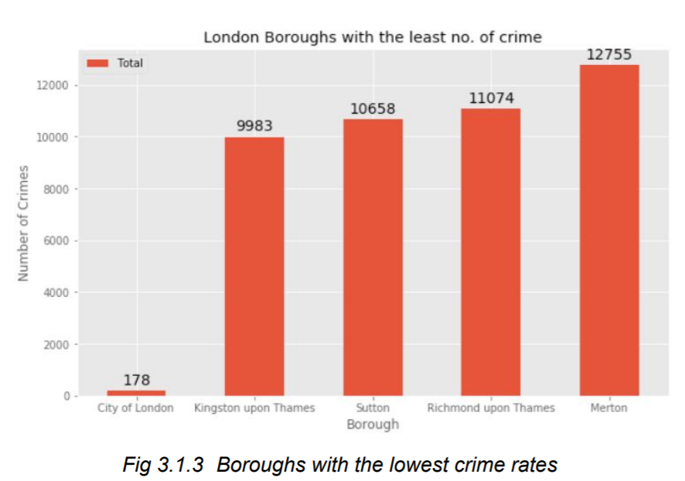
Boroughs with the lowest crime rates:
Comparing five boroughs with the lowest crime rate during the year 2016, City of London has the lowest recorded crimes followed by Kingston upon Thames, Sutton, Richmond upon Thames and Merton.

Slide 8
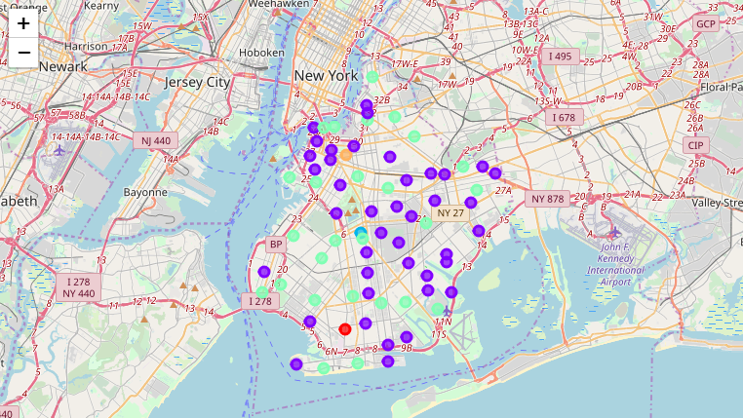
Neighborhoods in Kingston upon Thames maps:

Slide 9
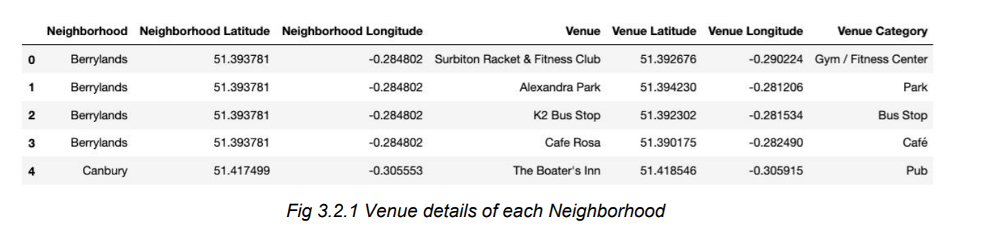
Modelling:
Using the final dataset containing the neighborhoods in Kingston upon Thames along with the latitude and longitude, we can find all the venues within a 500 meter radius of each neighborhood by connecting to the Foursquare API. This returns a json file containing all the venues in each neighborhood which is converted to a pandas dataframe. This data frame contains all the venues along with their coordinates and category .
One hot encoding is done on the venues data. (One hot encoding is a process by which categorical variables are converted into a form that could be provided to ML algorithms to do a better job in prediction). The Venues data is then grouped by the Neighborhood and the mean of the venues are calculated, finally the 10 common venues are calculated for each of the neighborhoods. To help people find similar neighborhoods in the safest borough we will be clustering similar neighborhoods using K - means clustering which is a form of unsupervised machine learning algorithm that clusters data based on predefined cluster size. We will use a cluster size of 5 for this project that will cluster the 15 neighborhoods into 5 clusters. The reason to conduct a K- means clustering is to cluster neighborhoods with similar venues together so that people can shortlist the area of their interests based on the venues/amenities around each neighborhood.

Slide 10
Results:
After running the K-means clustering we can access each cluster created to see which neighborhoods were assigned to each of the five clusters. Looking into the neighborhoods in the first cluster .
The cluster one is the biggest cluster with 9 of the 15 neighborhoods in the borough Kingston upon Thames. Upon closely examining these neighborhoods we can see that the most common venues in these neighborhoods are Restaurants, Pubs, Cafe, Supermarkets, and stores. Looking into the neighborhoods in the second, third and fifth clusters, we can see these clusters have only one neighborhood in each.

Slide 11
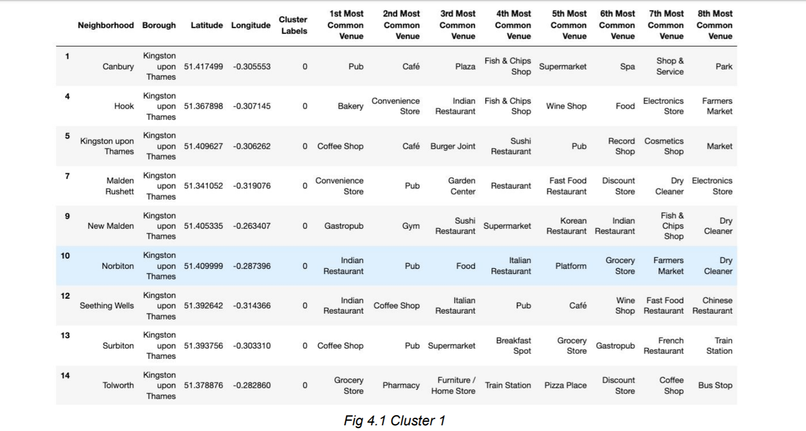
Cluster 1:
The cluster one is the biggest cluster with 9 of the 15 neighborhoods in the borough Kingston upon Thames. Upon closely examining these neighborhoods we can see that the most common venues in these neighborhoods are Restaurants, Pubs, Cafe, Supermarkets, and stores. Looking into the neighborhoods in the second, third and fifth clusters, we can see these clusters have only one neighborhood in each.

Slide 12
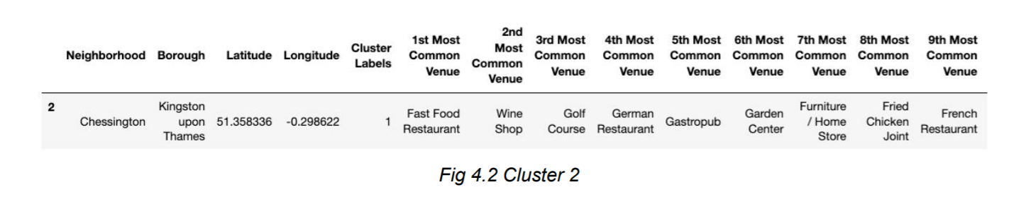
Cluster 2:
The second cluster has one neighborhood which consists of Venues such as Restaurants, Golf courses, and wine shops

Slide 13
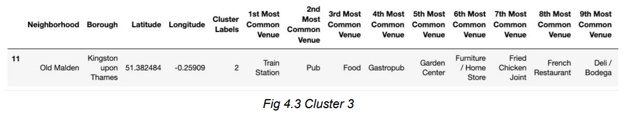
Cluster 3:
The third cluster has one neighborhood which consists of Venues such as Train stations, Restaurants, and Furniture shops.

Slide 14
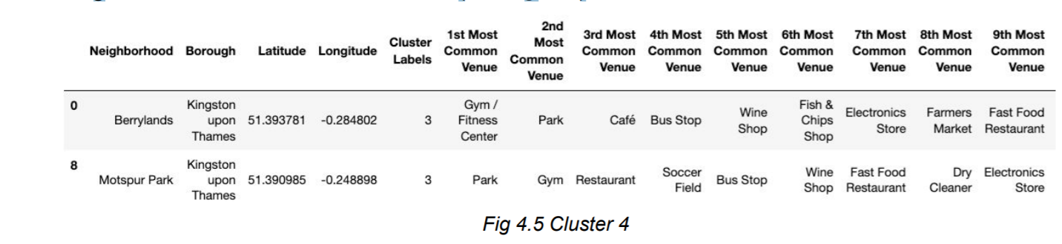
Cluster:4
The fourth cluster has two neighborhoods in it, these neighborhoods have common venues such as Parks, Gym/Fitness centers, Bus Stops, Restaurants, Electronics Stores and Soccer fields etc. Visualizing the clustered neighborhoods on a map using the folium library (see fig 4.6).

Slide 15
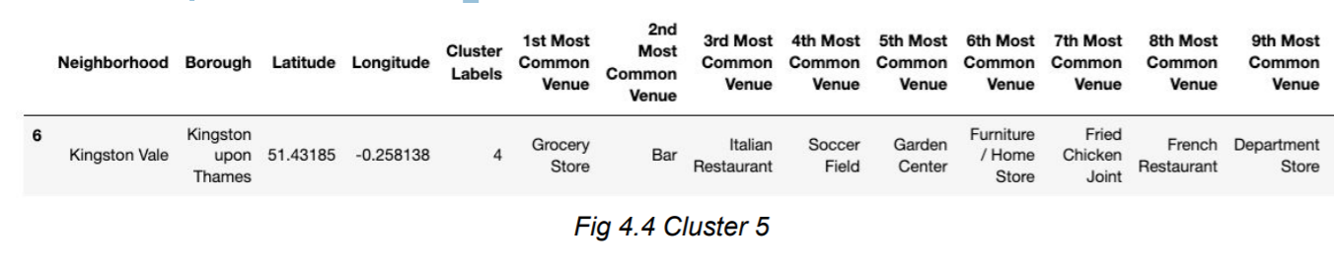
Cluster 5:
The fifth cluster has one neighborhood which consists of Venues such as Grocery shops, Bars, Restaurants, Furniture shops, and Department stores. We will look into the neighbourhoods in the fourth cluster (see fig 4.5).

Slide 16
Discussion:
The aim of this project is to help people who want to relocate to the safest borough in London, expats can chose the neighborhoods to which they want to relocate based on the most common venues in it. For example if a person is looking for a neighborhood with good connectivity and public transportation we can see that Clusters 3 and 4 have Train stations and Bus stops as the most common venues.
If a person is looking for a neighborhood with stores and restaurants in a close proximity then the neighborhoods in the first cluster is suitable.
For a family I feel that the neighborhoods in Cluster 4 are more suitable dues to the common venues in that cluster, these neighborhoods have common venues such as Parks, Gym/Fitness centers, Bus Stops, Restaurants, Electronics Stores and Soccer fields which is ideal for a family. The choices of neighborhoods may vary from person to person

Slide 17
Conclusion:
This project helps a person get a better understanding of the neighborhoods with respect to the most common venues in that neighborhood.
It is always helpful to make use of technology to stay one step ahead i.e. finding out more about places before moving into a neighborhood.
We have just taken safety as a primary concern to shortlist the safest borough of London. The future of this project includes taking other factors such as cost of living in the areas into consideration to shortlist the borough, such as filtering areas based on a predefined budget.

Slide 18
Thanks!!!

